Slide 1
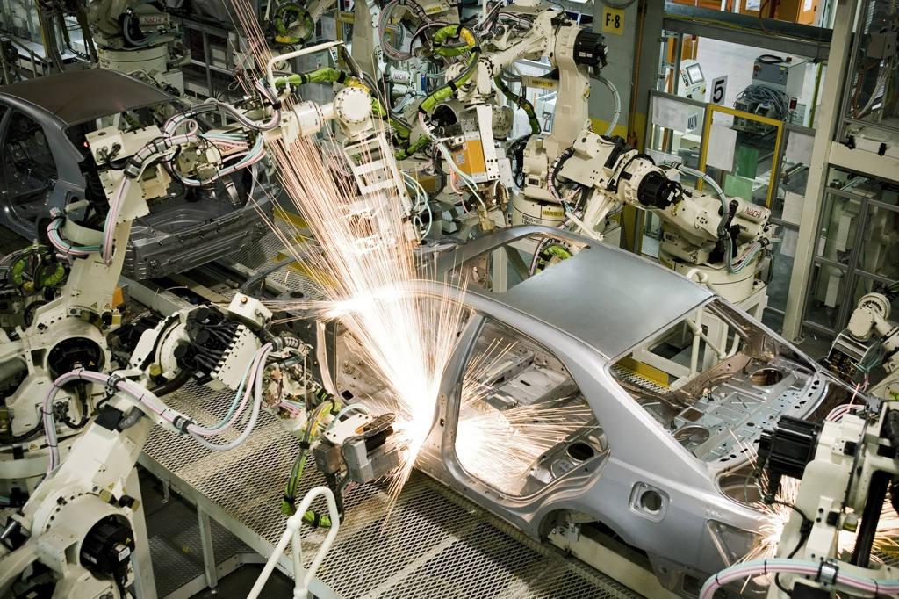
APDP Vision 2020
Can we do it?
Dr Johan van Zyl
President and CEO: Toyota SA Motors
Managing Officer: Toyota Motor Corporation
Notes:
ADD Speaker Notes

Slide 2
Contents
Background
The Motor Industry
  Global Relevance
  SA Contribution & importance
The Motor Industry Vision (1.2m by 2020)
  Evaluation of Building blocks
  Further improvements
Conclusion

Slide 3
1. Background

Slide 4
1. Background: Roadmap
Roadmap for Industry Vision
2011: Feedback & updated building blocks (1.2m target)
2008: 1 million target set
2013 – 2020
2006: Building blocks determined
Automotive Production Development Plan (APDP)
1995 – 2012
Motor Industry Development Programme (MIDP)
1989 – 1994
Phase 6 Local Content Programme
1989
2000
2010
2020

Slide 5
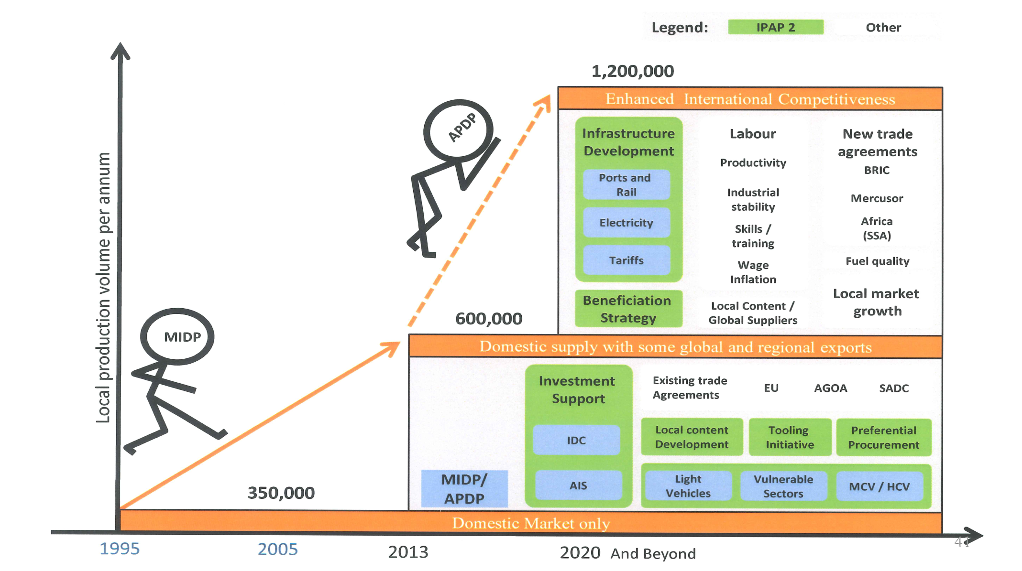
1. Background: Roadmap
Roadmap to achieving 1.2m & international competitiveness

Slide 6
2. The Motor Industry

Slide 7
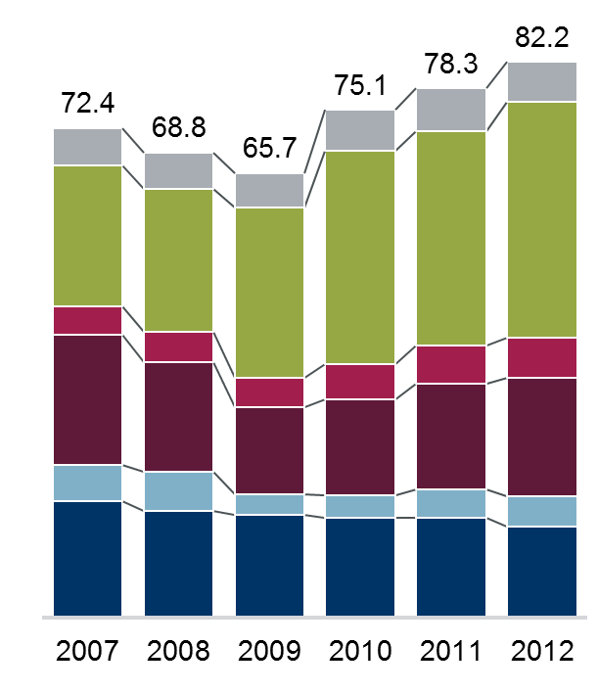
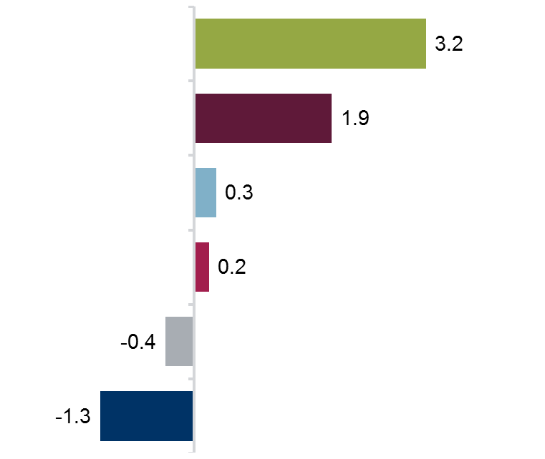
Vehicle Sales by Region
2. Motor Industry: Global Relevance
Sales (million units)
Change 2012 vs. 2011 (millon units)
+3.9
Asia-Pacific
Rest of World
North America
Asia-Pacific
Central and
Eastern Europe
South America
South America
North America
Central and
East Europe
Rest of World
West Europe
Western Europe
Source: VDA, IHS Global Insight, Automobile Manufacturers Ass & Toyota estimate

Slide 8
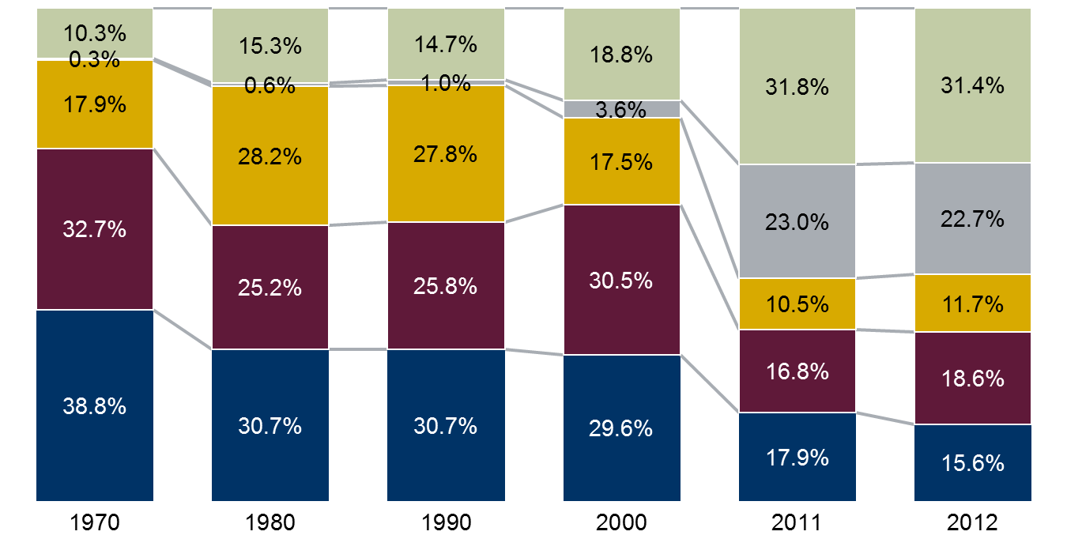
Vehicle Production by Region
2. Motor Industry: Global Relevance
Structure in %
Rest of World
China
Japan
North
America
Western
Europe
Million Units
 | 29.539 | 39.145 | 48.468 | 57.814 | 80.115 | 84.812
Source: VDA, IHS Global Insight & Toyota calculation

Slide 9
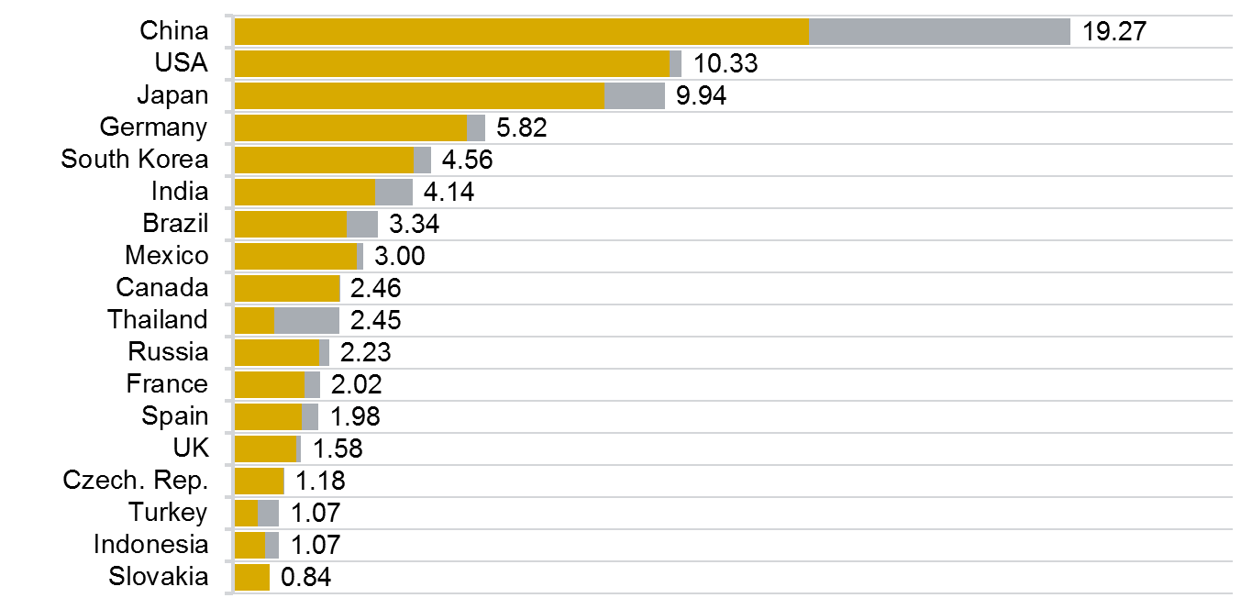
Most Important Production Countries
2. Motor Industry: Global Relevance
Rank
2012
(2011)
million units
1. | (1.)
2. | (2.)
3. | (3.)
4. | (4.)
5. | (5.)
6. | (6.)
7. | (7.)
8. | (8.)
9. | (11.)
10. | (14.)
11. | (12.)
12. | (10.)
13. | (9.)
14. | (13.)
15. | (15.)
16. | (16.)
17. | (17.)
18. | (21.)
Cars
CV
SA 0.64%
Ranked 25th
Anmerkung: teilweise geschätzt
Source: VDA, Polk Germany, press information, note: partly estimated, car production USA, Canada and Mexico = cars & LCV

Slide 10

2. Motor Industry: Global Relevance
Jan-Mar 2013 World Passenger/LCV Market Growth/Decline: Market: +11,9%
North America
Western Europe
Central and Eastern Europe
Showing signs of recovery (Sept 2013)
5,6%
-9,8%
-4,4%
South America
Rest of the World
Asia Pacific
4,5%
6,8%
-1,5%

Slide 11
2. Motor Industry: Global Relevance
SA Auto Production vs. Global Production
Year | 2008 | 2009 | 2010 | 2011 | 2012
Global vehicle Production | 70.52Mio | 61.7 Mio | 77.9 Mio | 79.89 Mio | 84.14 Mio
SA vehicle Production | 0.563 Mio | 0.374 Mio | 0.472 Mio | 0.533 Mio | 0.539 Mio
SA share of Global Production | 0.8% | 0.61% | 0.61% | 0.67% | 0.64%

Slide 12
2. Motor Industry: Global Relevance
Auto exports as % of total exports
Year | 1995 | 2000 | 2007 | 2008 | 2009 | 2010 | 2011 | 2012
Total SA Exports (R Billion) | 102.1 | 210.4 | 494.4 | 656.0 | 515.4 | 584 | 712.1 | 717.9
Total Automotive Exports (R Billion) | 4.2 | 23.4 | 67.6 | 94.2 | 61.0 | 69.5 | 82.2 | 86.9
Automotive exports as a % of total SA exports | 4.1% | 11.1% | 13.7% | 14.4% | 11.8% | 11.9% | 11.5% | 12.1%

Slide 13
2. Motor Industry: SA Contribution
Automotive Sector Share of GDP

Slide 14
2. Motor Industry: SA Contribution
Automotive Industry Employment Levels

Slide 15
2. Motor Industry: SA Contribution
Contribution to balance of trade (2012)
Actual 2012
Automotive trade balance if there was no local motor manufacturing industry (est.)

Slide 16
2. Motor Industry: SA Contribution
Motor industry trade balance
-49.2
-38.6
-30.7
-18.9
Source: AIEC

Slide 17
2. Motor Industry: SA Contribution
Motor Industry contribution to total exports
% of total SA Exports (Value)
13% | 14% | 14% | 14% | 15% | 12% | 12% | 12% | 14%
Source: NAAMSA

Slide 18
2. Motor Industry: SA Contribution
Local content
Source: NAAMSA

Slide 19
2. Motor Industry: SA Contribution
MIDP key performance indicators: 1995 vs. 2012
 | 1995 | 2012
Capital expenditure by the OEMs | R0.8 billion | R4.7 billion
Export value (vehicles and components) | R4.2 billion | R86.9 billion
Units exported | 15 765 | 277 8936
Productivity (vehicles produced per employee) | 10.0 | 18.5
Automotive industry contribution to GDP | 6.5% | 7.0%
Number of vehicles produced | 389 392 | 539 538
Source: AIEC

Slide 20
2. Motor Industry: SA Contribution
Automotive trade balance ratio
Source: AIEC

Slide 21
3. The Motor Industry Vision

Slide 22
3. Motor Industry Vision: Building Blocks
1.2m production by 2020
Export
?
Investment
Cost Competitiveness
?
Local Supplier Base
?
Domestic Market growth/size
?
Stable Political & Economic Policy
Automotive Production Development Program

Slide 23
3. Motor Industry Vision: Building Blocks
1.2m production by 2020
Export
Investment
Cost Competitiveness
Local Supplier Base
Domestic Market growth/size
Stable Political & Economic Policy
Automotive Production Development Program

Slide 24
3. Road Map: Domestic Market
Domestic market forecast for 2020 Vision Achievement
SA motor market needs to grow by 6.7% compounded per annum. (Over last 10 years the motor market has outperformed the GDP growth at a rate of 7.3% vs. 3.4%)
The ratio of CBU imports vs. locally manufactured vehicles needs to remain at 60% (Over last 10 years this ratio has increased from 30% to 61%)
Source: NAAMSA

Slide 25
3. Building Blocks: Export Market
Task for motor vehicle export for 2020 Vision Achievement
SA motor vehicle export needs to grow by 190%. (Over last 10 years the motor market has grown by 152%)
Vision 1,2 mil
The percentage of CBU export to total manufacturing needs to grow to 67% (Over last 10 years this ratio has increased from 25% to 54%)
Source: NAAMSA

Slide 26
3. Motor Industry Vision: Building Blocks
1.2m production by 2020
Export
Investment
Cost competitiveness
Local content
Labour
Cost Competitiveness
Local Supplier Base
Domestic Market growth/size
Stable Political & Economic Policy
Automotive Production Development Program

Slide 27
3. Building Blocks: Competitiveness
Cost Competitiveness
<Metal Pressings>
Source: AIDC
Indicator | External Factors | Internal Factors | Impact on overall Costing
Material cost - scrap | India average of 10% cheaper than SA | SA firms internal reject rate is 1.6% higher than India | 8.9% impact on costing
Direct labour cost - OEE | India 222% cheaper than SA | SA 24% less efficient than India | 12% impact on costing
Indirect labour cost - OEE | India 324% cheaper than SA | 24% less efficient that India | 12% impact on costing
Overheads cost |  | 24% less efficient that India | 3% impact on costing
Overall Costing Impact | - | - | 36.27%
25%
11.25%

Slide 28
3. Building Blocks: Competitiveness
Cost Competitiveness
<Iron Castings>
Source: AIDC
Indicator | External Factors | Internal Factors | Impact on overall Costing
Material cost | SA on average 8% cheaper than India due to shortage of Scrap in India | SA firms internal rejection rate is 2.2% higher than India | 2.9% positive impact
Direct labour cost | India 222% cheaper than SA | SA 15.5% less efficient than India | 21.42% negative impact
Indirect labour cost | India 324% cheaper than SA | 15.5% less efficient than India | 27.38% negative impact
Electricity cost | SA still 26% cheaper - costed at R0.95kWh | SA 5.5% more energy efficient | 3.29% positive impact
Overheads cost | - | 15.5% less efficient than India | 2.5% negative impact
Overall Costing Impact | - | - | 45.15%
Internal & External Factors Impact
12.5%
32.66%

Slide 29
3. Building Blocks: Value Chain
Localisation Image
Excluding. engine & gearbox
Imported
Imported in Local
Local

Slide 30
3. Building Blocks: Value Chain
Current local content levels (average)
XX%: % of total material cost material cost YY%: true local material plus value add as % of total
Exterior
10%
Electrical / Electronic
Glass
Paint
Bumpers
Mirrors
Harnesses
Starter motors
Alternators
Wiper systems
HVAC
3%
19%
5%
Interior
Cockpit
Seats
Door panels
Carpets
23%
Body
7%
15%
Bonnets
Bootlids
Sideframes
Doors
6%
Axles
Differentials
Drive shafts
Brakes
Chassis and Drive-train
Note: %’s indicative only
33%
14%

Slide 31
3. Building Blocks: Value Chain
Challenges in expanding and deepening local content
Electrical / Electronic
Exterior
Low volumes / economies of scale
Frequently changing technology
Distance from design centres
Interior
Differing raw materials
specs (resins, carpets)
Differing technologies
Body
Local steel quality
Local steel specifications
Investment costs
Differing OEM
specifications
Local steel quality
Local steel specifications
Chassis and Drive-train

Slide 32
3. Building Blocks: Value Chain
Why are we not competitive?
Strong/ fluctuating currency
Logistics and localisation disadvantage
Our local contents and high V to V component content?
Our production volume?
Our productivity with high wage demands?
Mindset?
In my opinion it is a combination of factors

Slide 33
3. Roadmap: Competitiveness
<Counter Measures>
Logistics
  New rail capacity for the SA industry (Transnet investment of R500m in automotive wagons to date & R300billion over the next 7 years)
  Port costs reduction short term (R1bn rebate given to exporters) and long term (cargo dues reduction)
  Port capacity improvement
  Accelerated document management
  Maximising coastal services between ports
Labour
  Fundamental reform
  Changes in collective bargaining process
  Joint collaborative process between government, industry & labour to find sustainable solution to create labour stability and supply.

Slide 34
3. Roadmap: Value Chain
<Counter Measures>
Localisation
  Supplier competiveness improvement
    ASCCI announced by Min Davies at JIMS opening
    Supply chain competitiveness improvement through increased production capacity, gainful employment and sector economic transformation
  OEM purchasing council activities
    OEM’s combining supplier volumes for greater economies of scale.
    Introduction of new automotive technologies and growth in local content.

Slide 35
3. Roadmap: Value Chain
<Counter Measures>
Localisation
  Beneficiation (from raw materials upstream)
    Gov. initiative to restrict exports of scrap metals will assist with local beneficiation.
    Gov. strategy for “Developmental” pricing on local raw materials is critical to achieving lower auto parts costs in SA.
    Refocus on aluminium foundry competitiveness and new products
  Automotive Administration System (AAS) by 5 OEM’s:
    Ensuring that the APDP delivers local value addition (VA)
    Tracking of local suppliers VA and local materials usage.
    Unlocking of tier 2 and 3 VA.
    Deepening of supply chain by increasing VA and material localisation.

Slide 36
4. Conclusion

Slide 37
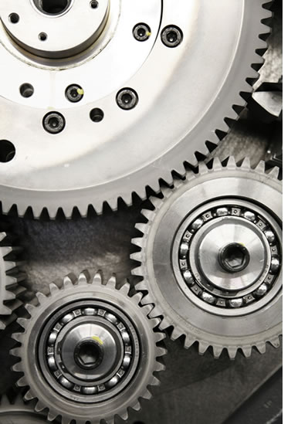
4. Conclusion
To achieve 1.2m is a huge task and challenging vision.
Achievement is dependant on global and domestic GDP growth.
Need to grow export but also encourage importers to produce locally.

Slide 38
Thank You

